Slide 1
Our DevOps Journey is Incomplete without Data
Data is the lifeblood of the system of the business
Data, Architecture & Data Management Practices Need Love & Attention
BMK Lakshminarayanan
Notes:
Organizations everywhere struggle with one specific, real problem with their continuous delivery pipelines: their data. In this session, BMK Lakshminarayanan of the Bank of New Zealand will share some of his experience with solving data-related issues and what advice he has for those facing similar challenges. He will also discuss what other data-related challenges remain and will need collaboration to resolve.

Slide 2
Flow
Problem Context
Context, Statistics, Impact
Challenges
Ownership, Silo, Locking, Standards
Solution Approach
Conventions, Architecture, Refactor
Recommendations
Useful Resources
Remaining Challenges
Call for Action
@LBMKRISHNA

Slide 3
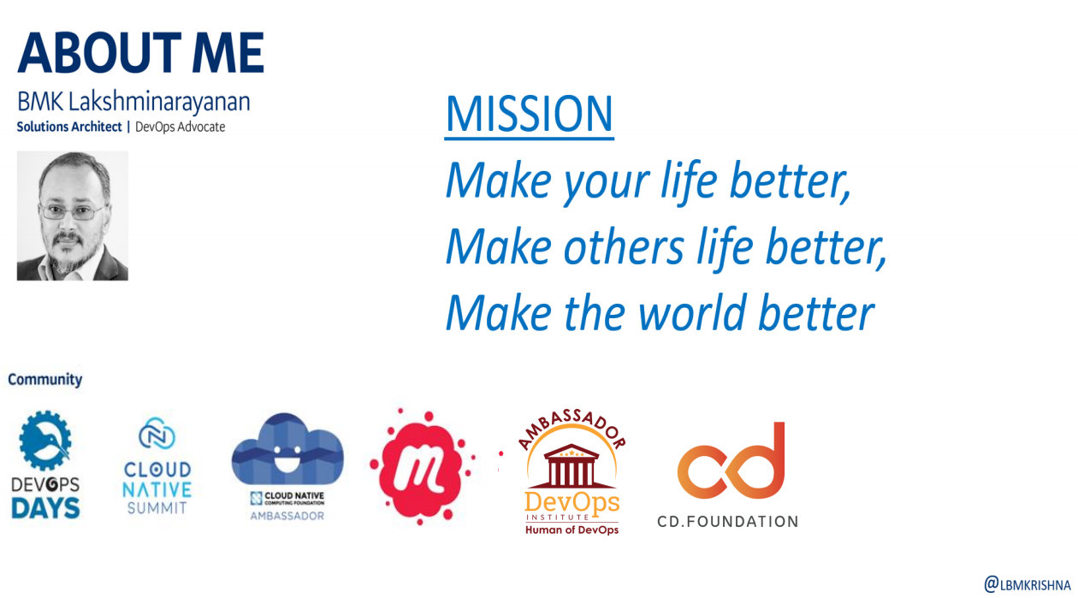


Slide 4
Context
Understanding Our Problem
Continuous Delivery, DevOps & Data

Slide 5
Problem Context
Manual database deployments continue to be a Software delivery bottleneck
Speeding up database releases are most difficult
Neglecting the data in our DevOps, Continuous Delivery processes has significant “Business Impact”
Data issues continue to slow us down, trouble our efforts to continuously integrate, test & deploy
@LBMKRISHNA

Slide 6
Statistics
46%
23%
Extremely or very difficult to speed database releases
High risk of deployment failure & extra downtime due to database changes
20%
57%
We are slow due to traditional siloed database development practices
Application changes require corresponding database changes
Source :https://www.devopsdigest.com/the-state-of-database-deployments-in-application-delivery-2019
@LBMKRISHNA

Slide 7

Yesterday’s DBA
@LBMKRISHNA
Notes:
•Gatekeepers
•Specialized
•Superheroes
•Siloed
•Master Builders

Slide 8
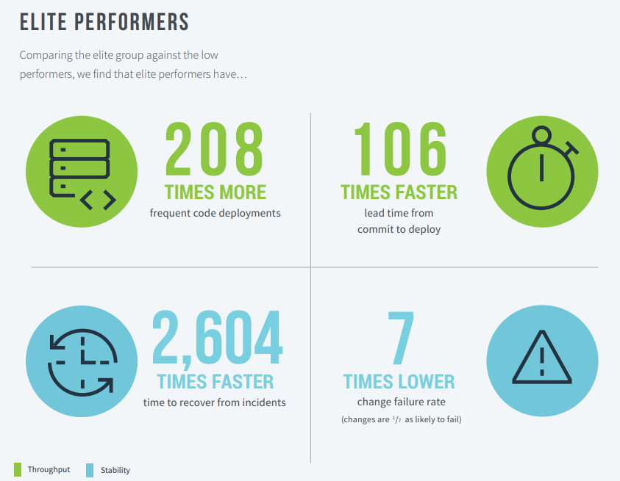
State of DevOps Report 2019
How do we compare?
https://services.google.com/fh/files/misc/state-of-devops-2019.pdf
@LBMKRISHNA

Slide 9
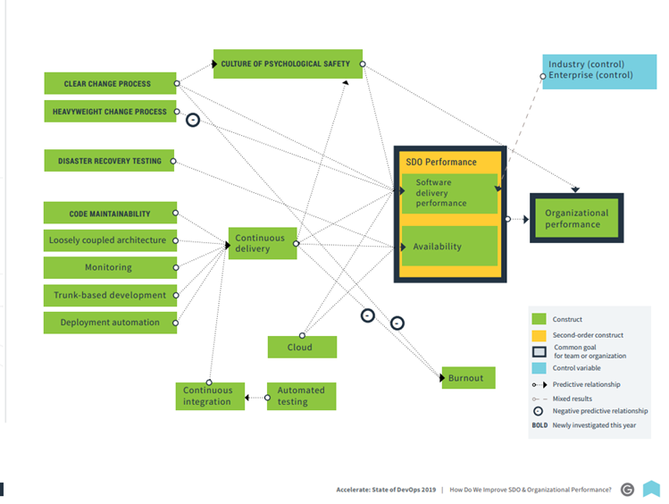
State of DevOps Report 2019
IT Performance ->
Organization Performance
https://services.google.com/fh/files/misc/state-of-devops-2019.pdf
@LBMKRISHNA

Slide 10
Challenges
Understanding Challenges
Data - Silo, Ownership, Inherited Practices
Notes:
Who owns the Data?
Let us dive deep into the “Data” problem. The typical mentality in any Enterprise is that the “Data Team” or “Data Management Team” owns the data. There is a prevalent idea that they are the only team to protect data from unauthorised access, maintain the standards and conventions, “owning” the data and that they are the very last defence system in the organisation.
The question is, how did we get into this situation? The term “Silo” in DevOps hits me hard, as I see that the Data Team is the biggest silo in the entire Organisation and Value chain.
The problem, is it Data, the Data People or both?
In typical Object-Oriented programming style, I see that the “Enterprise Data team” inherits a lot from their predecessors. They inherit the process, standards, procedures, planning, execution, operations and management. The challenge is recognising and accepting the opportunity to improve, modernise, and simplify. i.e. apply lean principles. And they were making things developer-friendly to be the most significant barrier. Sometimes it is a mix of emotions for me — anger, sadness and pity.

Slide 11
Enterprise Data Challenges
🔻
🔻
How do we think about data?
Decade old standards & conventions
🔻
🔻
Inherited data management practices
Centralize data team to design, model, deploy & operate
@LBMKRISHNA
Notes:
If improving our daily work and the way we work is more important than the work itself, why we could not help them & take them along this DevOps journey?
We are responsible for our System Complexity
IMHO — The root of the problem for most organisations is:
How do we think about data? Application, Operational, Analytical, Intelligence. This includes data from apps, log files, monitoring, performance, core systems, lake, files, message hubs.
Struggling to understand the reality of Real Time vs Batch? and Impact of that in our business decisions
Data in Business Events and the flow of that event data within Enterprise between different systems? How we move the data within the Enterprise between different producers & consumers?
How to “Unlock” the data and make it available for right users, right use cases
Data Constraints that we live with due to tools, process and practices
Let us honestly answer these following questions? My list is long, but let us start with this:
How many of us know how many ETL jobs exist in our Enterprise? How many of them are still active?
For storing scripts, Do we trust “Shared Network” drive than a “Source Control” system?
Do we believe that we are sourcing the Data only one time from the “Source” system/systems?
Do we have or provide clarity to our “Dev” community on Systems of Record vs Systems of Engagement?
We believe that building massive databases even with modern “Enterprise-Grade Modern Database” tools, is the right thing to do.
We believe that applying the same 30 years old naming conventions and standards to even modern databases, is the right thing to do.
We believe that preventing the “data” access in Dev, Test from “Developers” and making them do TBD (Ticket Based Development) — is that right thing to do.
We believe that not giving the “PROD” database “read” access to support folks and expect them to “Production Support” is that right thing to do.

Slide 12
Who is Responsible?
Our system complexities are because of our thinking, thinking particularly about the “Data”. We tend to compromise a lot as we could not get the “Data” in the right way, at the right time, in the proper format
We need to level up our game
Data, Data Architecture, Data Management & Associated Practices need our love & attention
@LBMKRISHNA
Notes:
Our System Complexities are because of our thinking, thinking particularly about the “Data”. We tend to compromise a lot as we could not get the “Data” in the right way, at the right time, in the proper format.
Sometimes these constraints, we impose on ourselves — classic example due to Data Governance, Data Security, Data Normalization, Data Centralization.

Slide 13
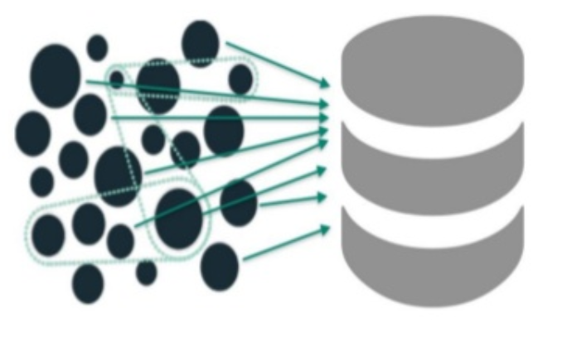
Architecture Mismatch
Microservices Era & Big Ball of “Data” mud
Mum asked me to share Database
@LBMKRISHNA
Notes:
Our System Complexities are because of our thinking, thinking particularly about the “Data”. We tend to compromise a lot as we could not get the “Data” in the right way, at the right time, in the proper format.
Sometimes these constraints, we impose on ourselves — classic example due to Data Governance, Data Security, Data Normalization, Data Centralization.

Slide 14
Solution Approach
Small Steps, But in Right Direction
Education, Conventions, Architecture, Shift Left

Slide 15
Solution Approach
➽
➽
Data Management Team Decentralize
Conventions & Standards
➽
➽
Educate,Upskill, Tools, Processes
Adopting Modern Practices
@LBMKRISHNA
Notes:
Breakthrough Challenges
It is not easy, but it is not impossible.
1) Naming Conventions: I would put this into our “Developer” productivity, the reason, having a meaningful data model, schema, table, column names are important for developers and Ops to do the right work. Instead of referring multiple documents for names, acronyms, we need better meaningful naming standards and conventions. It is “Freedom” from those constrained naming conventions of history. If you Enterprise has inherited old historical conventions of limited characters, it is now time to free them up. #DeveloperProductivity #DataArchitecture
2) Domain, Boundary, Schema: The DDD education is a fun exercise with Data & Data modelling team. This is tough ask with our Data friends. Traditionally we have build monolith applications with monolith databases; In some cases, even our depended applications have/had database/schema level integrations. If we are breaking the monolith and taking the route of DDD, Bounded Context, then we need to move to the database/service boundary. Try this following with you Data Architecture, Data Modelling team:
a) Request for Database/Service Boundary (if this fails, try the next)
b) Request for Schema/Service Boundary
After a round of discussion with my Data friends, we agreed on the Schema/Service Boundary. We could able to limit the dependencies/cross-domain pollution with this approach. Service Account/Schema for read & write access. aligning the domain to a schema (at least)
3) Flow — Requesting Data model changes: This is another area we improved significantly. Initially, we needed to fill a SharePoint form to request a data model change. This goes to the DA (Data Analyst & Data Modeller), he produces the script, reviewed by DBA & by the Developer who requested, then applied to DEV Database and the dev starts developing the features. We realised that we could not fit this in our 2 — weeks sprint.

Slide 16
Help Our Data Folks - Processes
Make the data first-class citizen
Source control - Database schema
Simply processes
Review changes early
CI/CD pipeline
“T” & “Comb” shaped
@LBMKRISHNA

Slide 17
Help Our Data Folks - Futuristic
“T” & “Comb” shaped
Data Engineers
Educator & Mentors
Platform Builders
@LBMKRISHNA

Slide 18
Help Our Dev & Ops Folks - Educate
Data Governance, Lineage
Compliance (PCI DSS, Data Privacy)
Regulations (GDPR, CCPA)
Data Security (PII)
Standards & Conventions (Naming, model, dictionary, catalogue)
Enable Self-Service (Database request, schema change request)
@LBMKRISHNA

Slide 19
Recommendations
Useful Resources
Upskill, Learn, Spread, Share

Slide 20
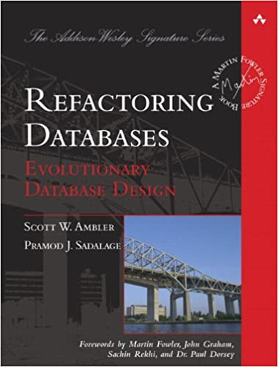


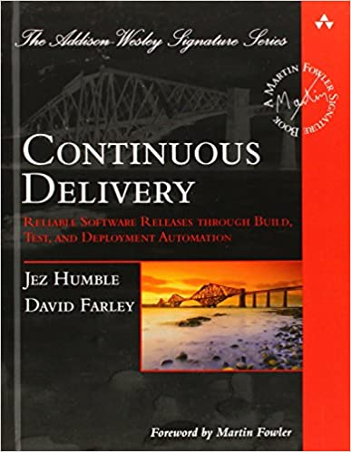

Recommendations
We need to level up our game
Data, Data Architecture, Data Management & Associated Practices need our love & attention
@LBMKRISHNA

Slide 21
Recommended Approach
Understanding current state (Tools, processes, roles, flow)
Making work visible (current workloads, workloads in pipeline)
Value Stream Management (New feature, Tech debt, Incident)
Upskilling (DevOps, CI/CD Practices, Automation)
Investment (Time, Tools, Self-service)
@LBMKRISHNA

Slide 22
Remaining Challenges
Collectively We Need Work, Collaborate
Call for Action

Slide 23
Help
Automated data governance
Policies via automation and in pipeline
Compliance as code
My dream
&
My vision
@LBMKRISHNA

Slide 24
Our DevOps Journey is Incomplete without Data
Data is the lifeblood of the system of the business
Data, Architecture & Data Management Practices Need Love & Attention
BMK Lakshminarayanan
Notes:
Organizations everywhere struggle with one specific, real problem with their continuous delivery pipelines: their data. In this session, BMK Lakshminarayanan of the Bank of New Zealand will share some of his experience with solving data-related issues and what advice he has for those facing similar challenges. He will also discuss what other data-related challenges remain and will need collaboration to resolve.

